Slide 1
CIS 490H/590J Edge Computing
Multi-Layer Computing:Cloud Comp.
Winter 2022
Prof. Zheng Song
zhesong@umich.edu

Slide 2
Outline
IoT and the Cloud
Web service
Quality of Service & Service Level Agreement
Service-Oriented Architecture
XaaS
Virtualization: Virtual Machine and Docker
Microservice and Serverless (Lambda Functions)
Some slides were adopted from Cornell CS5412 advanced cloud computing HTTP://WWW.CS.CORNELL.EDU/COURSES/CS5412/2022SP

Slide 3
IoT devices
Less powerful than computers
Embedded operating systems (or without OS)
Equipped with more wireless communication modules
WiFi, BLE, Cellular
RFID, Zigbee, Lora (long range, low rate)
Work with Sensors and controllers
Heterogeneity
Some powered by battery
Sensitive to energy efficiency
Low energy consumption (3~15W)
PC: 60~300 Watts
Laptop: 20~100 Watts
Server: 500 ~ 1200 Watts

Slide 4
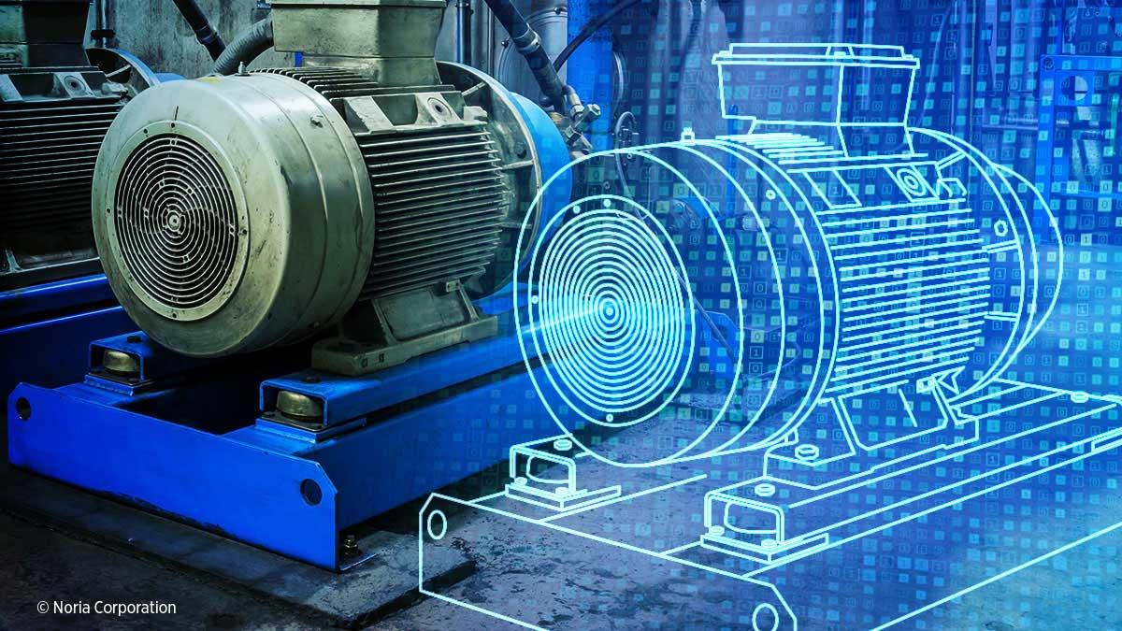
CONCEPT: DIGITAL TWIN
We often like to think of the cloud as having a software “image” that matches with IoT in the physical world.
The IoT devices are physical and live “outside” the cloud, but for each device we have a “digital twin” that lives inside the cloud, and is a kind of proxy. Actions on the twin are translated to reading the sensor or telling the actuator to do something.

Slide 5
Why use Cloud to Assist IoT?
Clouds reduces the need for advanced computing resources at the clients side
IoT systems can use inexpensive hardware and rely on cloud-based processing and storage resources
No need to buy software or software licenses
Data is no longer confined to the local storage, users will be able to access data and applications from anywhere at any time. There is no more lost data due to hard drive failures
https://www.thorntech.com/cloud-computing-foundation-internet-things/

Slide 6
Outline
IoT and the Cloud
Web service
Quality of Service & Service Level Agreement
Service-Oriented Architecture
XaaS
Virtualization: Virtual Machine and Docker
Microservice and Serverless (Lambda Functions)
Some slides were adopted from Cornell CS5412 advanced cloud computing HTTP://WWW.CS.CORNELL.EDU/COURSES/CS5412/2022SP

Slide 7
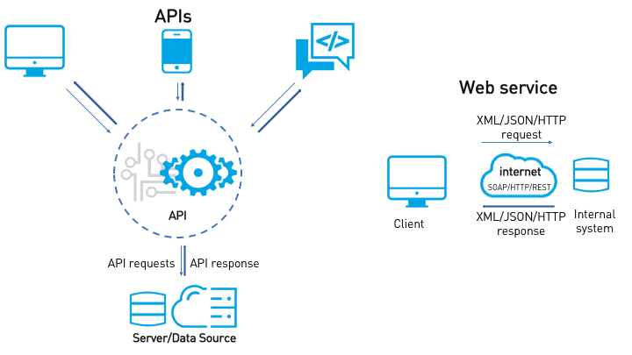
Web Services
The term Web service (WS) is either:
a service offered by an electronic device to another electronic device, communicating with each other via the World Wide Web, or
a server running on a computer device, listening for requests at a particular port over a network, serving web documents (HTML, JSON, XML, images).
In a Web service a Web technology such as HTTP is used for transferring machine-readable file formats such as XML and JSON.

Slide 8
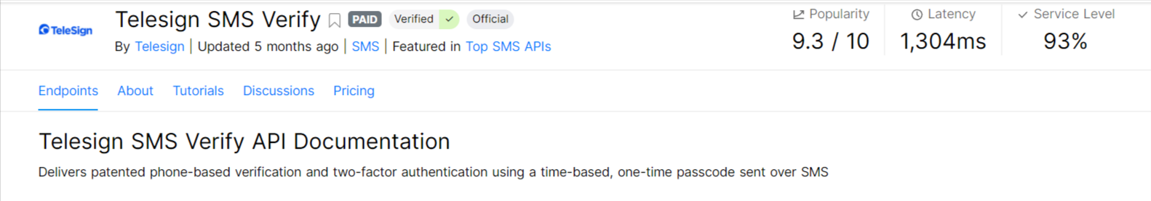
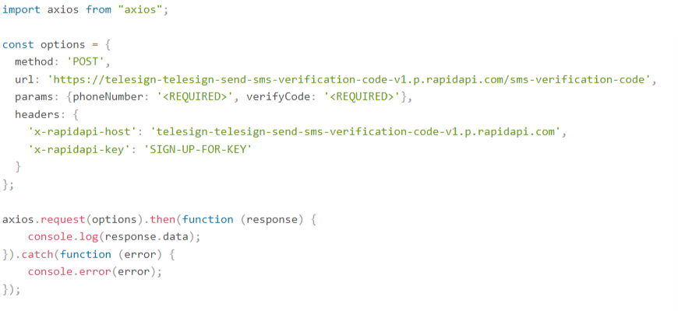
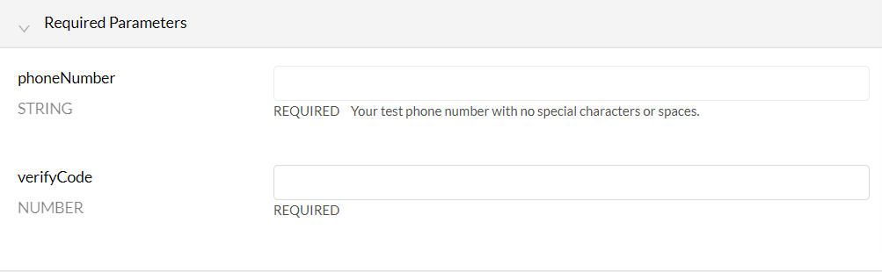
Web Service Example
https://rapidapi.com/telesign/api/telesign-sms-verify/

Slide 9
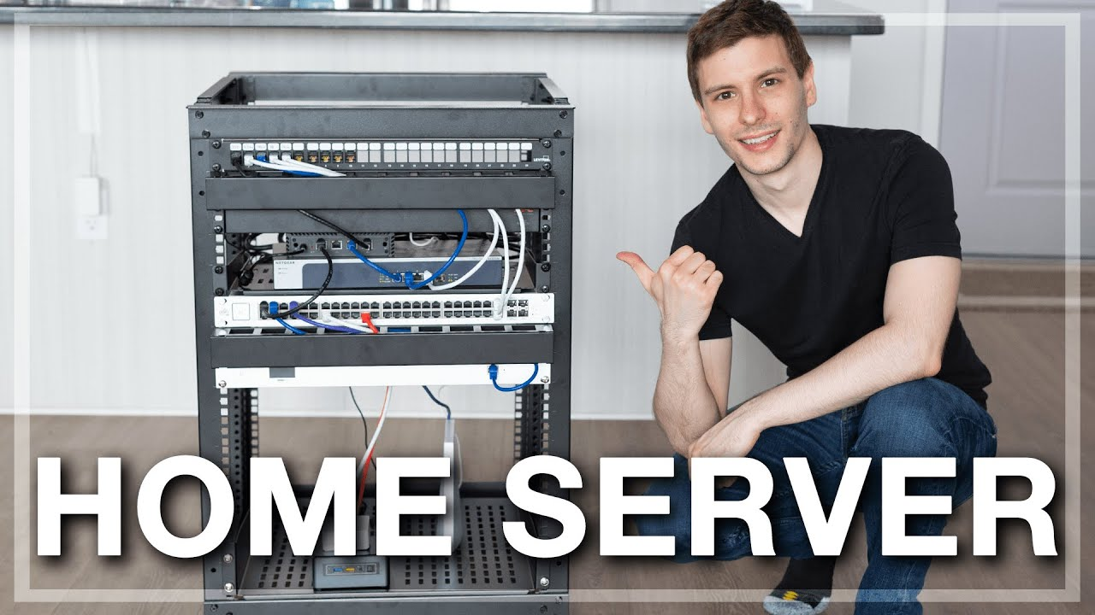
To provide a weather forecast web service?
Service Provider: You; Clients: Car Snow Removal Robots.
Collect the data and implement your business logic
Get an IP address, buy a computer, buy a domain name, DNS resolving
Someone
Is that enough?

Slide 10

Quality of Service (QoS) Matters!
QoS: latency, reliability, availability, …
It is important as it can impact your client’s experience!
Bad QoS ⇒ Angry Client => Less Business ⇒ No Profit!

Slide 11
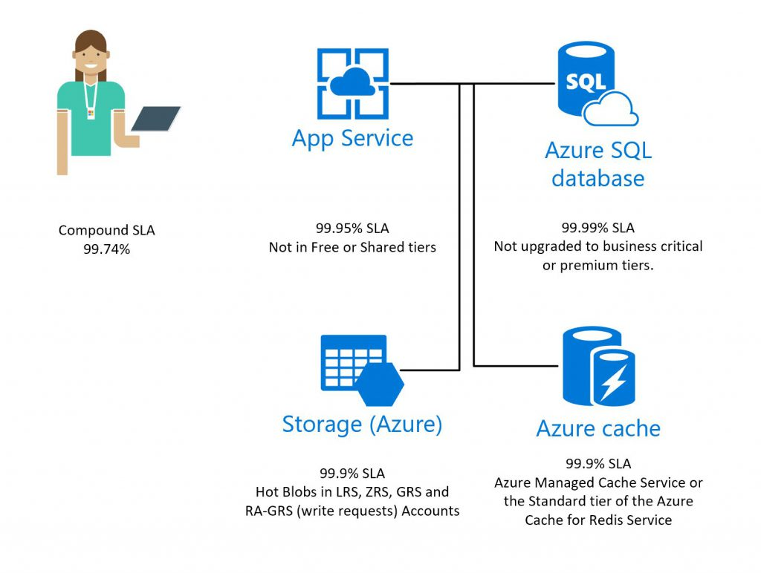
SLA: Service Provider’s Promise
Service Level Agreement: A service-level agreement (SLA) defines the level of service expected by a customer from a supplier, laying out the metrics by which that service is measured

Slide 12
To provide a weather prediction web service?
You promise that your service will be available 99.99%... but what if:
Your home network is down
Your server is down and need repair
Your cat eats the server!
You have more clients when it snows heavily!

Slide 13
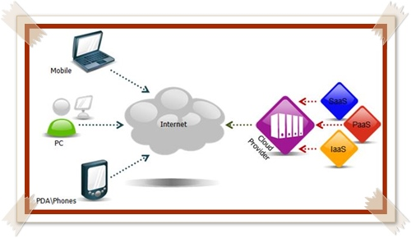
Cloud Computing kicks in
Two ways of deploying a web service:
Setup your own server
Rent cloud resources
Cloud Computing:
- resource pooling
- make it possible for users to focus on service logic
- automatically recover from failure
- automatically handle more clients for you (elasticity)

Slide 14
What is Cloud Computing?
“The provisioning of services in a timely (near on instant), on-demand manner, to allow the scaling up and down of resources”

Slide 15


What if …
You develop a new application (A/C control) that can also use weather forecast?
Service result, two options:
0 = turn on snow removal; 1 = turn off snow removal (can be used by app1, not by app2)
Temperature: can be used by both apps.
You want others to use your weather forecast?
Make your service discoverable to your clients
A file that describe your input and output standard

Slide 16
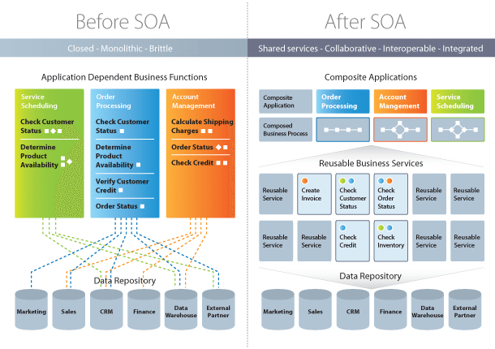
Service-oriented Architecture
For reusing services!

Slide 17
SOA Characteristics
Reusable: depending on their granularity, services can be used by multiple processes and other coarse-grained services. Services can be composed to form new services
Contract-based: interface and policies are strictly described by an interface specification. Service contracts are designed to be as independent of the service implementation as possible, minimizing the need for service contract changes if the implementation changes.
Discoverable and location independent: services are located through a service registry/catalogue and accessed via universal resource locators, and therefore may move over time without disruption to consuming systems.
Notes:
In a tightly coupled system, an implementation change (e.g. a change in a back-end data type) would require a change to the interface and therefore the connecting systems.

Slide 18
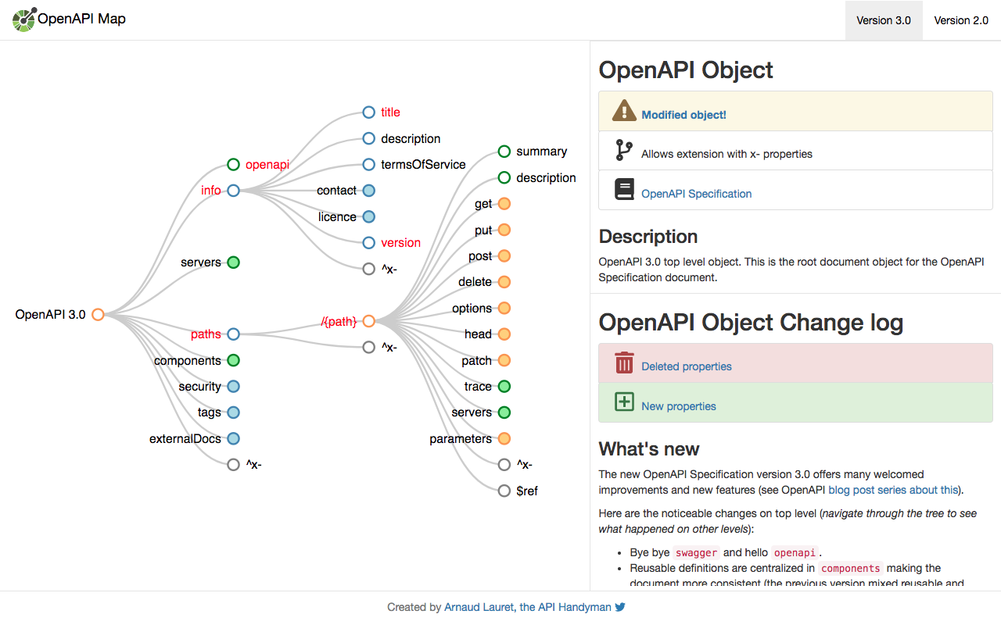
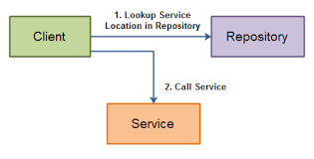
SOA Characteristics (cont.)
Service Repository: sharing information about services
WSDL/OpenAPI: web service definition language
Notes:
WSDL = WEB SERVICE DEFINED LANGAUGE]
The configuration file used to define input and output format of a service

Slide 19
Cloud computing, SOA, and web service
Cloud computing can be built upon:
Web services, i.e., HTTP (most widely used)
Messages: MQTT, RabbitMQ, etc. (frequently seen for IoT)
gRPC
Cloud computing inherits features of SOA:
QoS requirements
SLA guarantee

Slide 20
Outline
IoT and the Cloud
Web service
Quality of Service & Service Level Agreement
Service-Oriented Architecture
XaaS
Virtualization: Virtual Machine and Docker
Microservice and Serverless (Lambda Functions)
Some slides were adopted from Cornell CS5412 advanced cloud computing HTTP://WWW.CS.CORNELL.EDU/COURSES/CS5412/2022SP

Slide 21
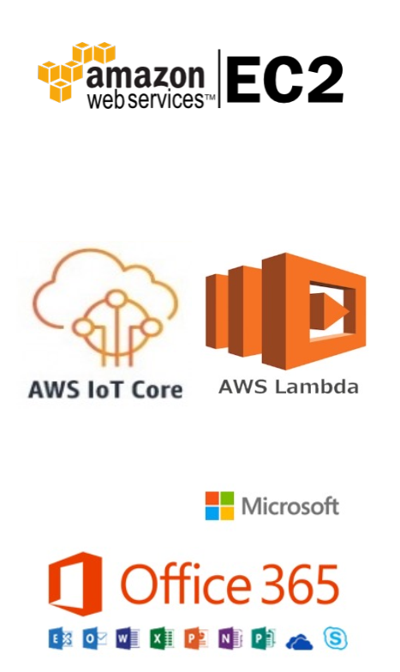
Cloud Computing
Definition: Cloud computing provides shared pool of configurable computing resource to end users on demand
Three Service Models:
IaaS (infrastructure as a service)
Virtual machines, storage, network, …
Amazon EC2, S3, cloudfront
PaaS (Platform as a service)
Execution runtime, middleware, web server, database, development tool
AWS IoT Core, AWS Lambda
SaaS (Software as a Service)
Email, virtual desktop, games…

Slide 22
Before the cloud
Application Logic
Providing a weather forecast web service
You manage and deploy:
Hardware and network
OS
Software
Data
Runtime
OS
Virtualization
You Manage
Server
Storage
Network

Slide 23



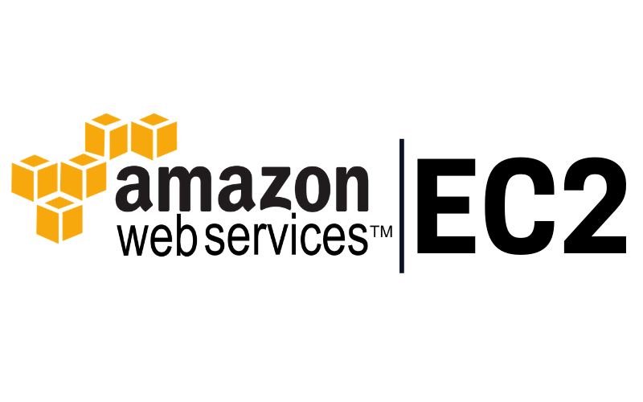
Infrastructure as a Service (IaaS)
Application Logic
IaaS:
“Physical server box”
Virtual machine:
Memory
Storage
CPU
Network
Example:
EC2
Have a cloud version of your home server
Data
You Manage
Runtime
OS
Virtualization
Server
Storage
Service Providers
Network

Slide 24

Platform as a Service (PaaS)
Application Logic
You Manage
PaaS:
You get a framework
Host applications
Example:
AWS IoT
Use Case:
Built up your smart A/C controller
Data
Runtime
OS
Virtualization
Server
Storage
Service Providers
Network

Slide 25
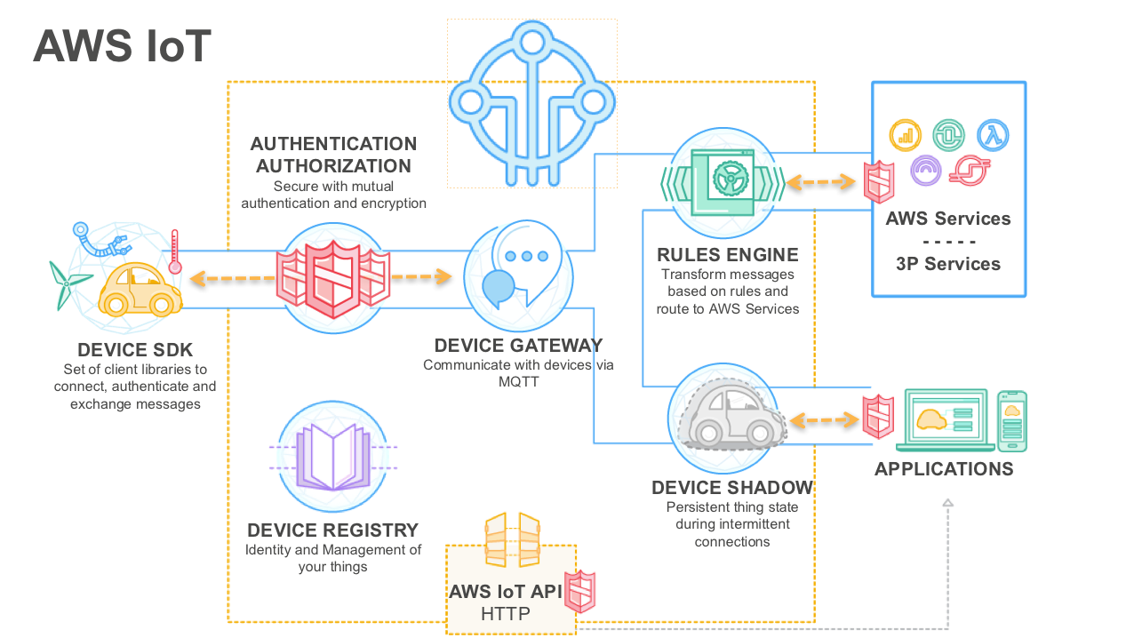
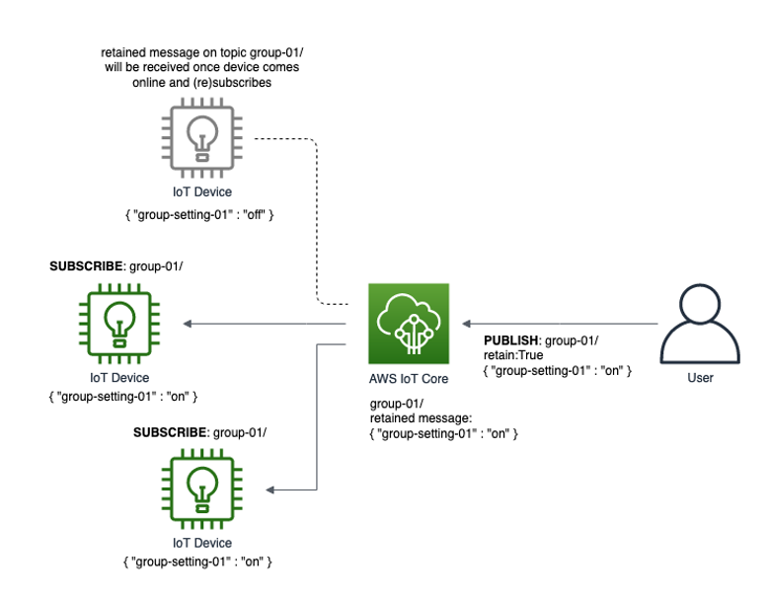
PaaS example: AWS IoT
Messaging Middleware: send messages between sensors and Servers

Slide 26
Software as a Service (SaaS)
Application Logic
SaaS: you get a whole solution
Example:
Gmail
Google slides
Office 365
Data
Runtime
OS
Service Providers
Virtualization
Server
Storage
Network

Slide 27
Outline
IoT and the Cloud
Web service
Quality of Service & Service Level Agreement
Service-Oriented Architecture
XaaS
Virtualization: Virtual Machine and Docker
Microservice and Serverless (Lambda Functions)
Some slides were adopted from Cornell CS5412 advanced cloud computing HTTP://WWW.CS.CORNELL.EDU/COURSES/CS5412/2022SP

Slide 28
The Virtual Server Concept
Virtualization is the ability to run multiple operating systems on a single physical system and share the underlying hardware resources*
It is the process by which one computer hosts the appearance of many computers.
Virtualization is used to improve IT throughput and costs by using physical resources as a pool from which virtual resources can be allocated.

Slide 29
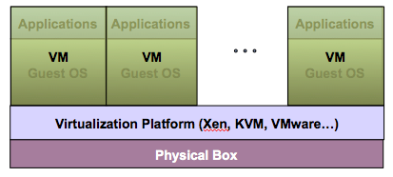
Virtual Machine
A Virtual machine (VM) is an isolated runtime environment (guest OS and applications)
Multiple virtual systems (VMs) can run on a single physical system

Slide 30
Hypervisors And Hosts
A hypervisor is a piece of computer software, firmware or hardware that creates and runs virtual machines.
A computer on which a hypervisor is running one or more virtual machines is defined as a host machine.
Each virtual machine has a guest operating systems, which is managed by the hypervisor.
Multiple instances of a variety of operating systems may share the virtualized hardware resources.

Slide 31
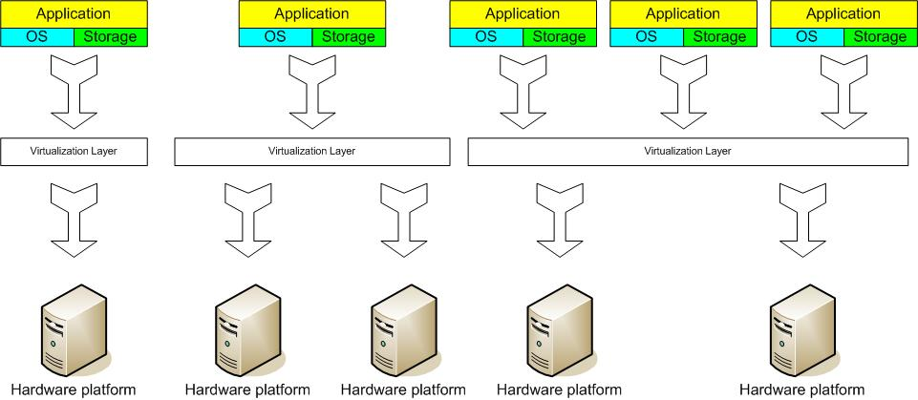
The Virtual Server Concept
Hypervisor layer between Guest OS and hardware

Slide 32
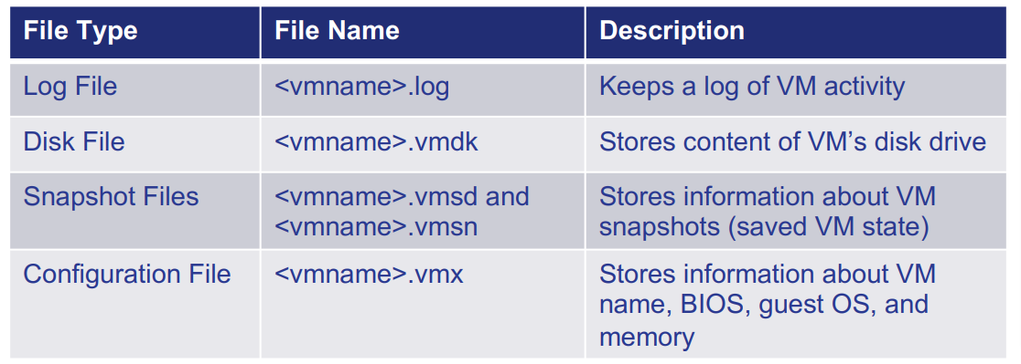
VM Snapshot
Virtual Machines are files…
VMs can be exported and moved to other hosts
Files are created by the hypervisor and stored in a directory
Example VM Files

Slide 33
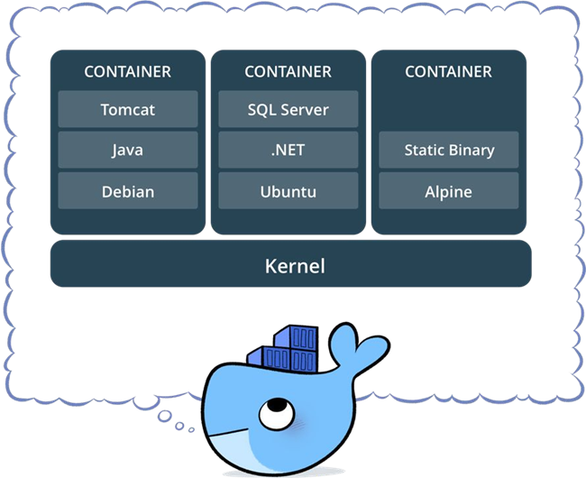
Container
Standardized packaging for software and dependencies
Isolate apps from each other
Share the same OS kernel Works for all major Linux distributions
Containers native to Windows Server 2016

Slide 34
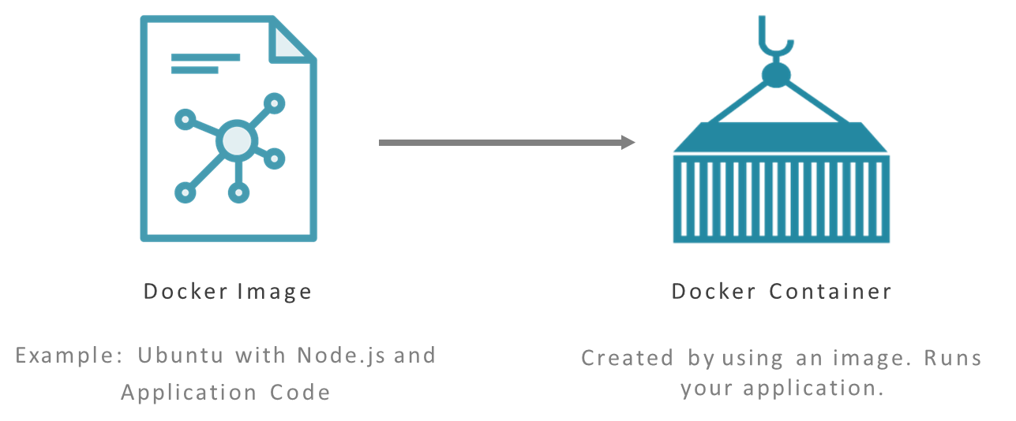
Docker Images and Containers

Slide 35
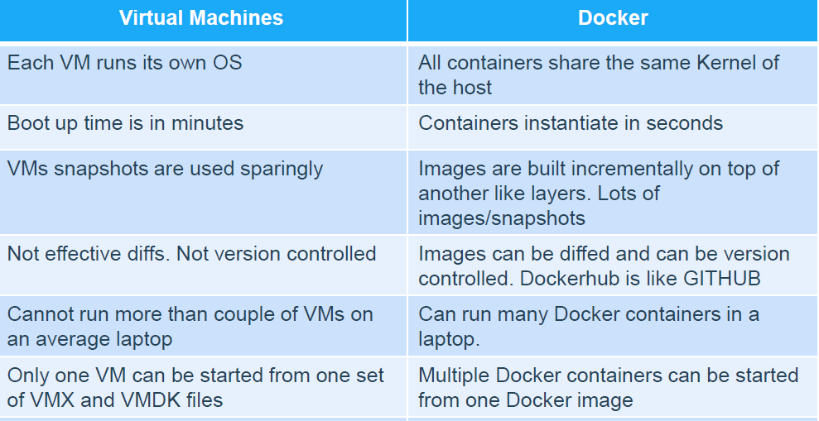
Docker Containers Vs. Virtual Machines
Fundamentally different architectures / Benefits

Slide 36
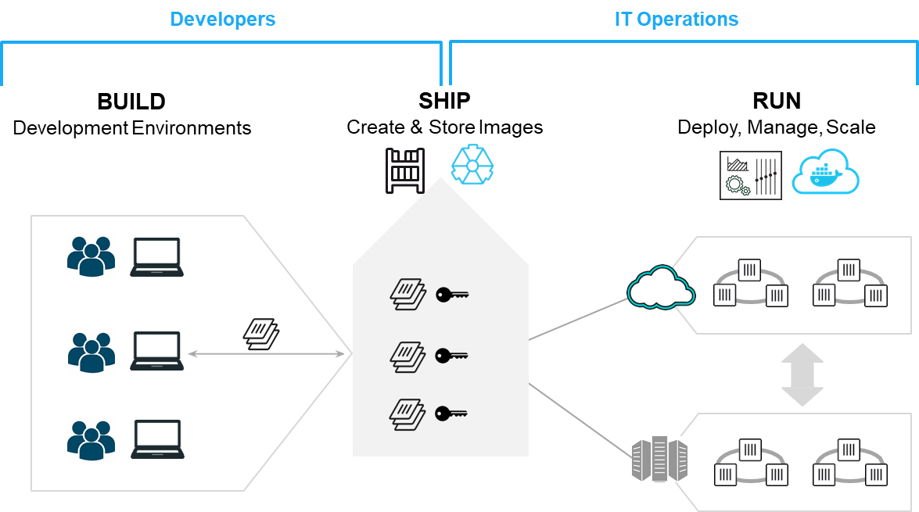
How to use docker

Slide 37
Benefits of Virtualization
Sharing of resources helps cost reduction
Isolation: Virtual machines are isolated from each other as if they are physically separated
Encapsulation: Virtual machines encapsulate a complete computing environment
Hardware Independence: Virtual machines run independently of underlying hardware
Portability: Virtual machines can be migrated between different hosts.

Slide 38
Virtualization in Cloud Computing
Cloud computing takes virtualization one step further:
You don’t need to own the hardware
Resources are rented as needed from a cloud
Various providers allow creating virtual servers:
Choose the OS and software each instance will have
The chosen OS will run on a large server farm
Can instantiate more virtual servers or shut down existing ones within minutes
You get billed only for what you used
allows these systems to scale up and down at will

Slide 39
Kubernetes
Kubernetes is a “container orchestrator” or “cluster manager”
Places containers on nodes
Recovers automatically from failure
Basic monitoring, logging, health checking
Service discovery and load balancing (allocate requests to containers)
Container and Kubernetes 101
https://www.youtube.com/watch?v=gFozhTXOx18

Slide 40
Outline
Web service
Quality of Service & Service Level Agreement
Service-Oriented Architecture
Cloud computing, XaaS, resource pooling
Virtualization: Virtual Machine and Docker
Microservice
Serverless (Lambda Functions)
Some slides were adopted from Cornell CS5412 advanced cloud computing HTTP://WWW.CS.CORNELL.EDU/COURSES/CS5412/2022SP

Slide 41
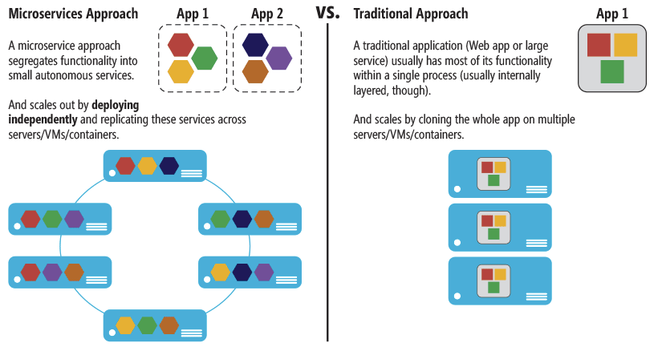
Microservice
Break down services into microservices

Slide 42
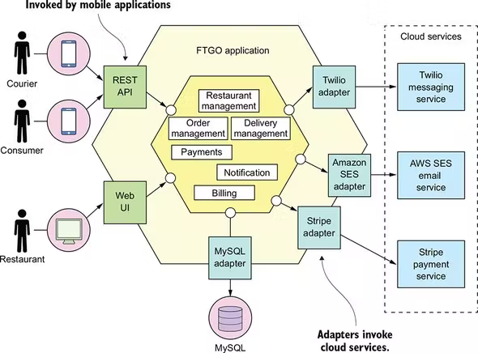
Example: Food to Go Application
Monolithic architecture:
Order management
Restaurant management
Delivery management
payment
…
All in one application
It works fine till…

Slide 43
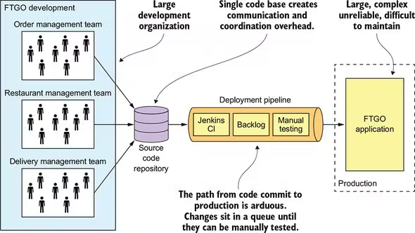
The application keeps growing
5 people FTGO team → Order team/kitchen team/delivery team ⇒ painful application update (testing and deployment)

Slide 44
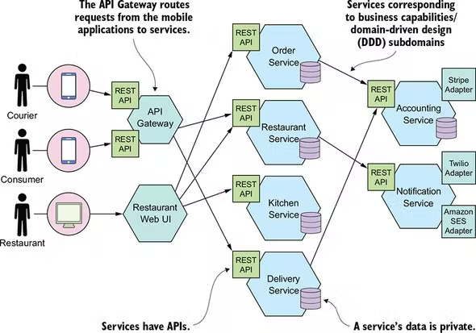
Microservice architecture for FTGO
Features:
Loosely coupled
event-driven

Slide 45
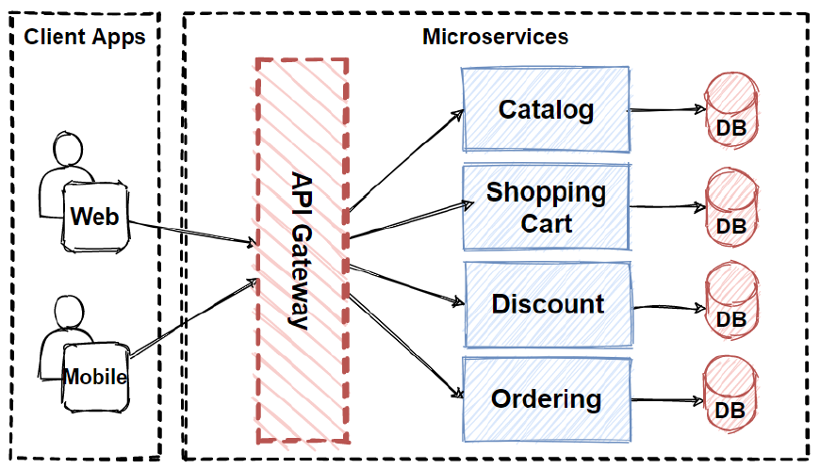
API gateway for microservice
Functions:
Authenticate
Log→ Performance
Caching
Routing
…

Slide 46
Microservice: pros and cons
Benefit:
Easier to develop and maintain
Freedom to choose the right technology
Individual deployment
Drawback:
Harder to debug the overall application

Slide 47
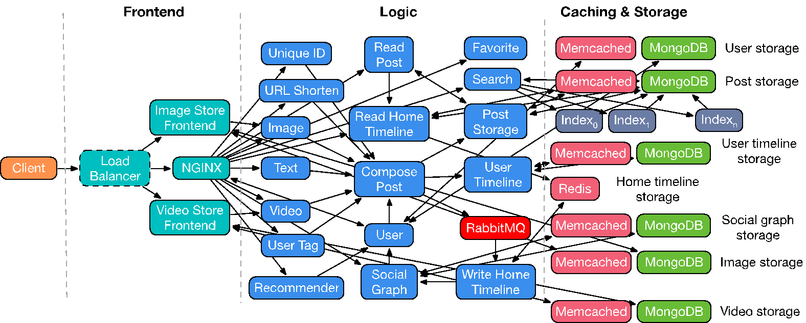
End-to-end Microservices (from Christina Delimitrou)
Social Network

Slide 48
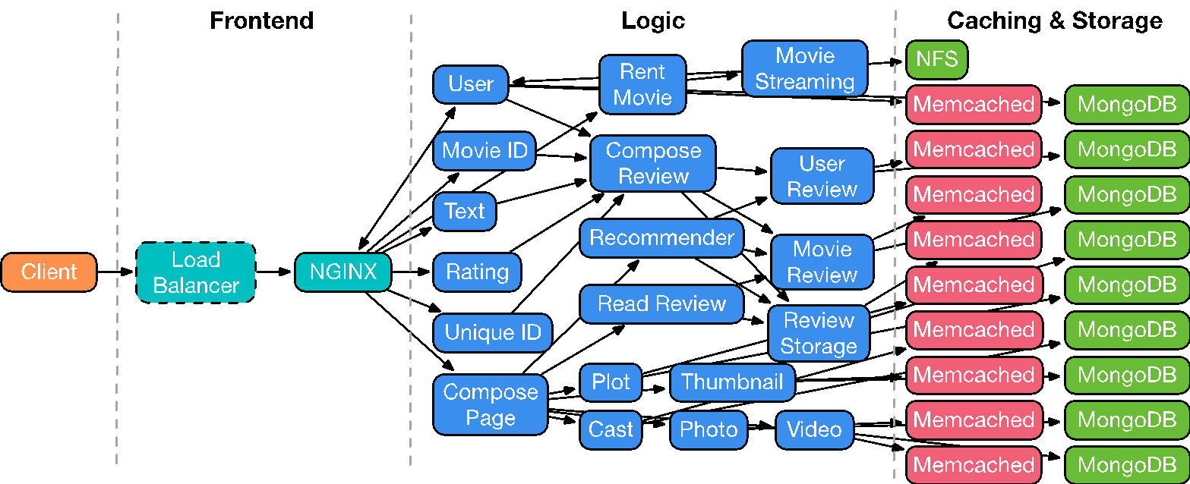
End-to-end Microservices (from Christina Delimitrou)
Media Service
Notes:
Goal is to add more resources to the services along the critical execution path (bottle neck)

Slide 49
Each Microservice is a parallel pool!
Every one of those little nodes is itself a small elastic pool of processes
A microservice is a kind of program designed so that the data center can run one instance… or many instances, “elastically”, to deal with dynamically varying demand.
Microservice Scheduling:
scheduler watched each μ-service pool (each is shown as one dot, with color telling us how long the task queue was, and the purple circle showing how CPU loaded it is).
Each time the scheduler realized that it should add instances to a slow service, some of the “deadline violations” went away.

Slide 50
Outline
Web service
Quality of Service & Service Level Agreement
Service-Oriented Architecture
Cloud computing, XaaS, resource pooling
Virtualization: Virtual Machine and Docker
Microservice
Serverless (Lambda Functions)
Some slides were adopted from Cornell CS5412 advanced cloud computing HTTP://WWW.CS.CORNELL.EDU/COURSES/CS5412/2022SP

Slide 51
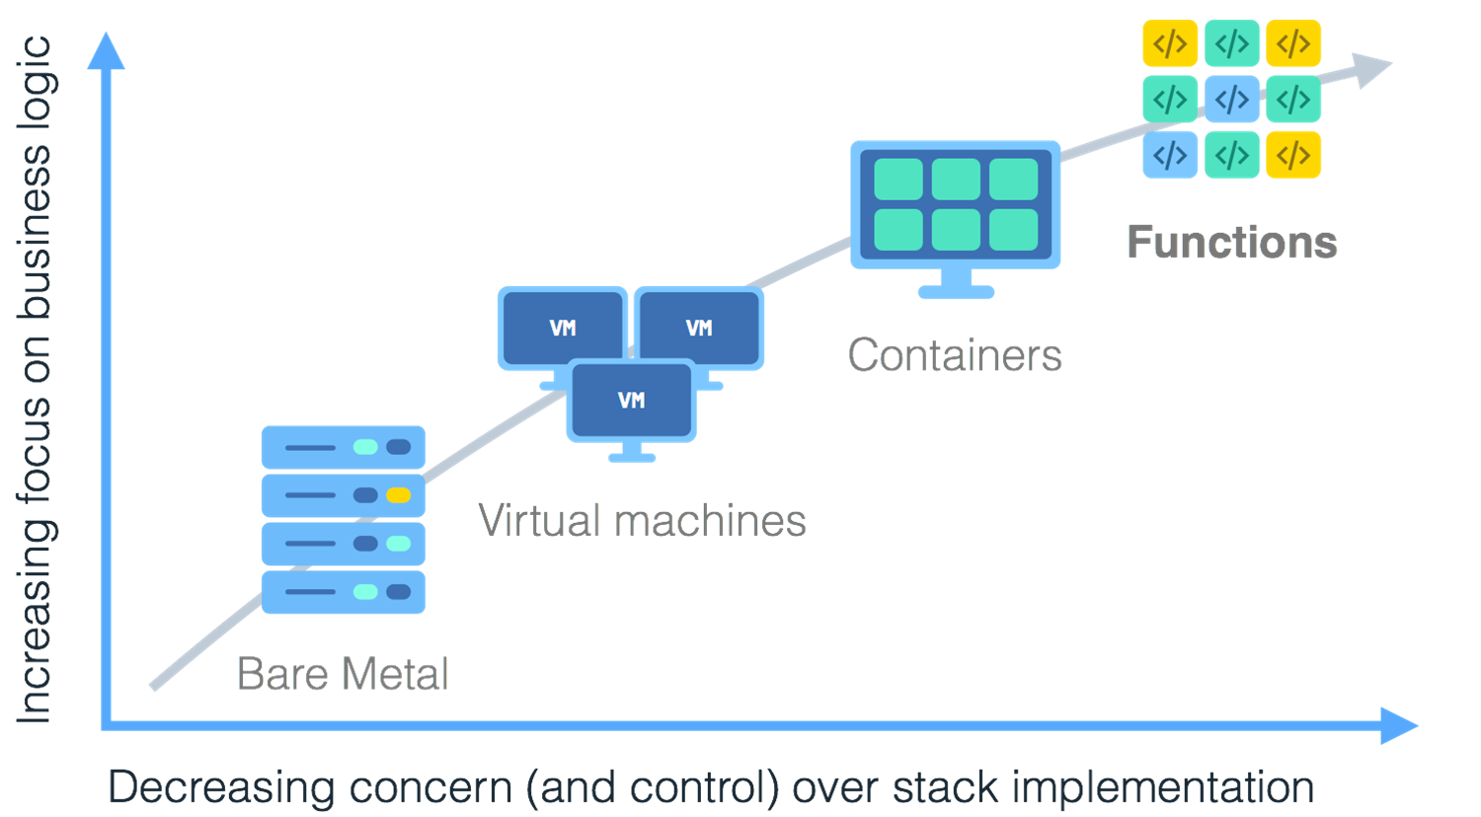
Serverless

Slide 52
What is Serverless
a cloud-native platform
for
short-running, stateless computation
and
event-driven applications
which
scales up and down instantly and automatically
and
charges for actual usage at a millisecond granularity
Notes:
Idea is that a machine does not have to be constantly running (like a virtual machine with Infrastructure as a service), rather, a single server (running for example an instance of a container or VM) will serve many people solely to run a function on that single virtual machine or container).
*thus it is in some applications more efficient, in both power, memory consumption, etc.

Slide 53
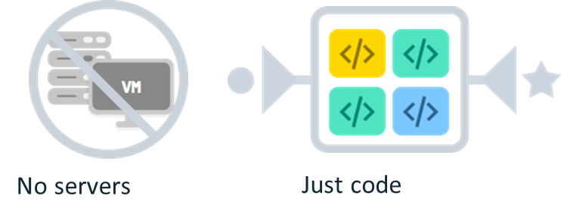
Server-less means no servers?
Or worry-less about servers?
Runs code only on-demand on a per-request basis in response to events

Slide 54
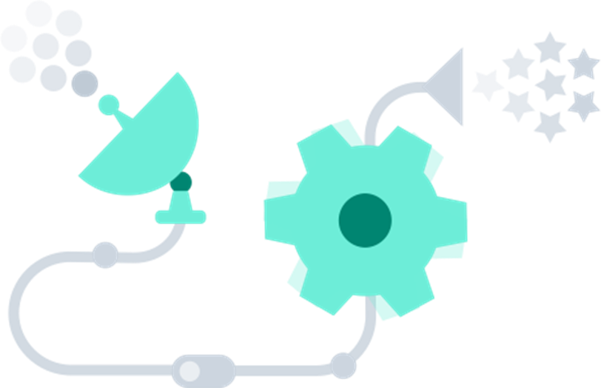
What triggers code execution?
Runs code in response to events
Event-programming model

Slide 55
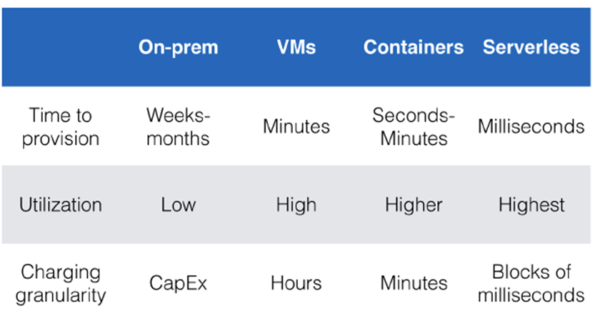
Why Serverless
•Making app development & ops dramatically faster, cheaper, easier
•Drives infrastructure cost savings
Notes:
On-premise software is installed locally, on your business' computers and servers
Capital expenditures (CapEx) are funds used by a company to acquire, upgrade, and maintain physical assets such as property, plants, buildings, technology, or equipment.

Slide 56
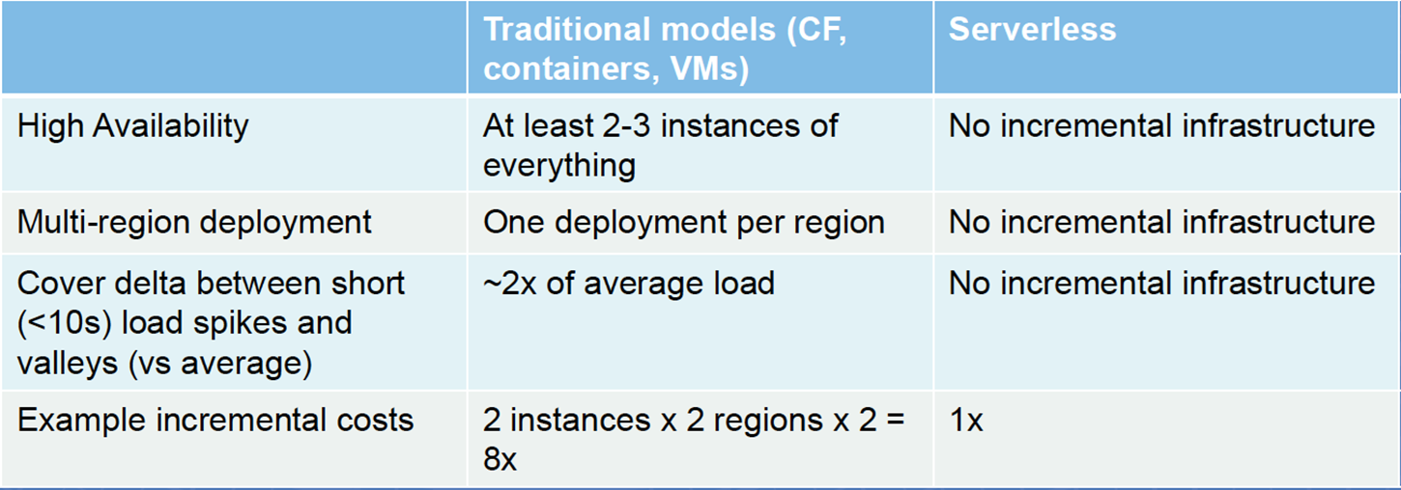
Key factors for infrastructure cost savings

Slide 57
What is Serverless good for?
Serverless is good for
short-running
stateless
Event-driven
Examples:
Microservices
Bots
IoT
Modest Stream Processing
Service Integration
Serverless is not good for
long-running
stateful
number crunching
Examples:
Databases
Deep Learning Training
Heavy-duty Stream Analytics
Numerical Simulation
Video Streaming

Slide 58
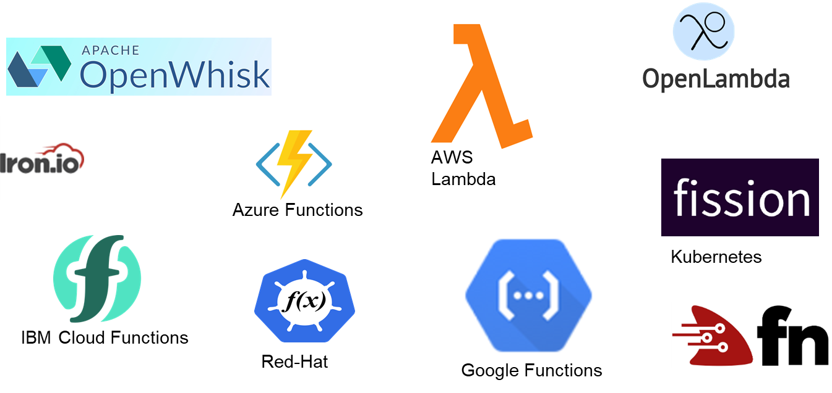
Current Platforms for Serverless
Highest market share: Lambda function of AWS

Slide 59
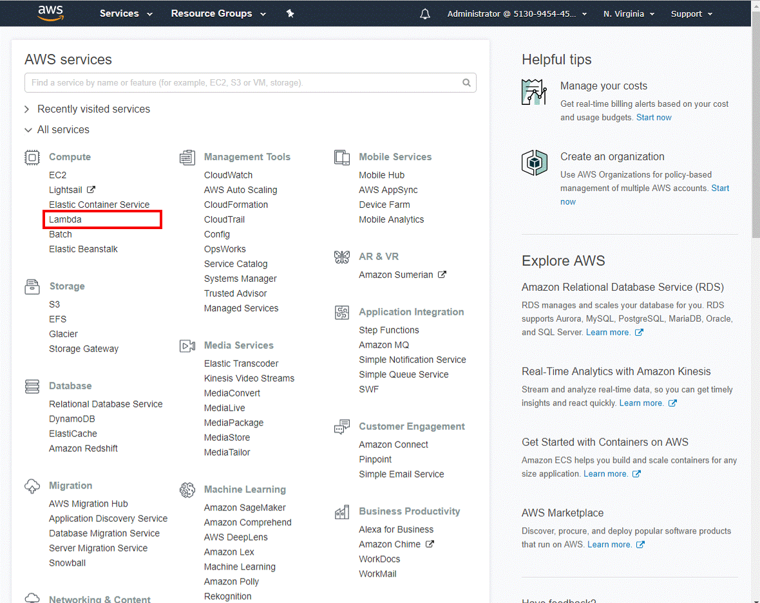
AWS Lambda Function

Slide 60
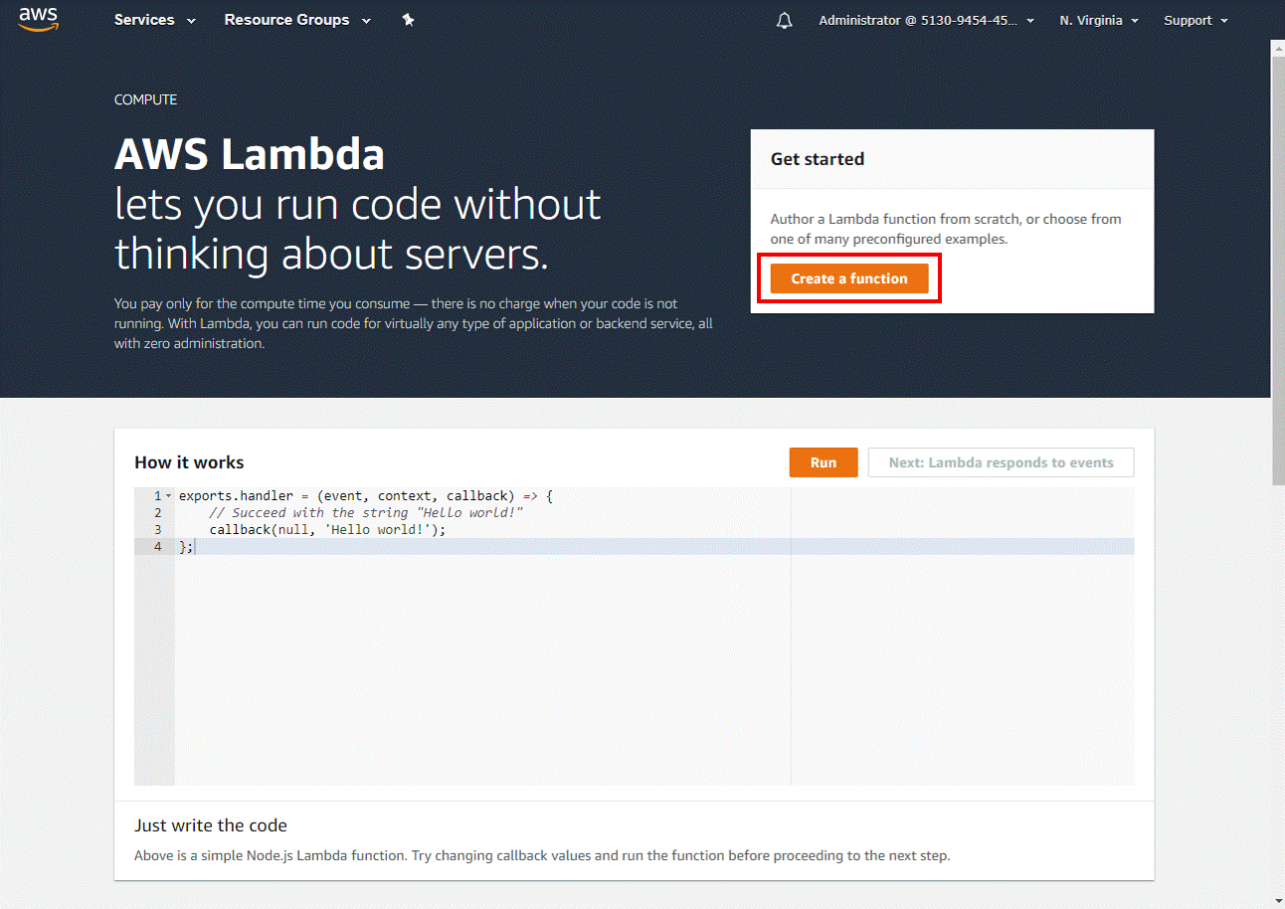
AWS Lambda Function

Slide 61
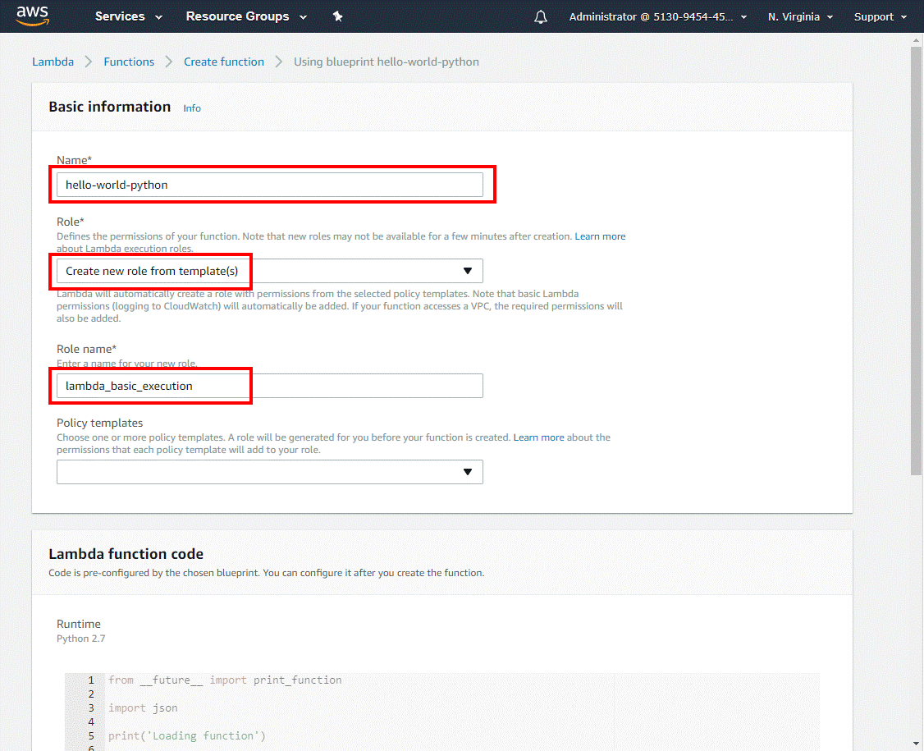
AWS Lambda Function
Role: permission
Runtime: C#, Java, Python
Handler: entrance

Slide 62
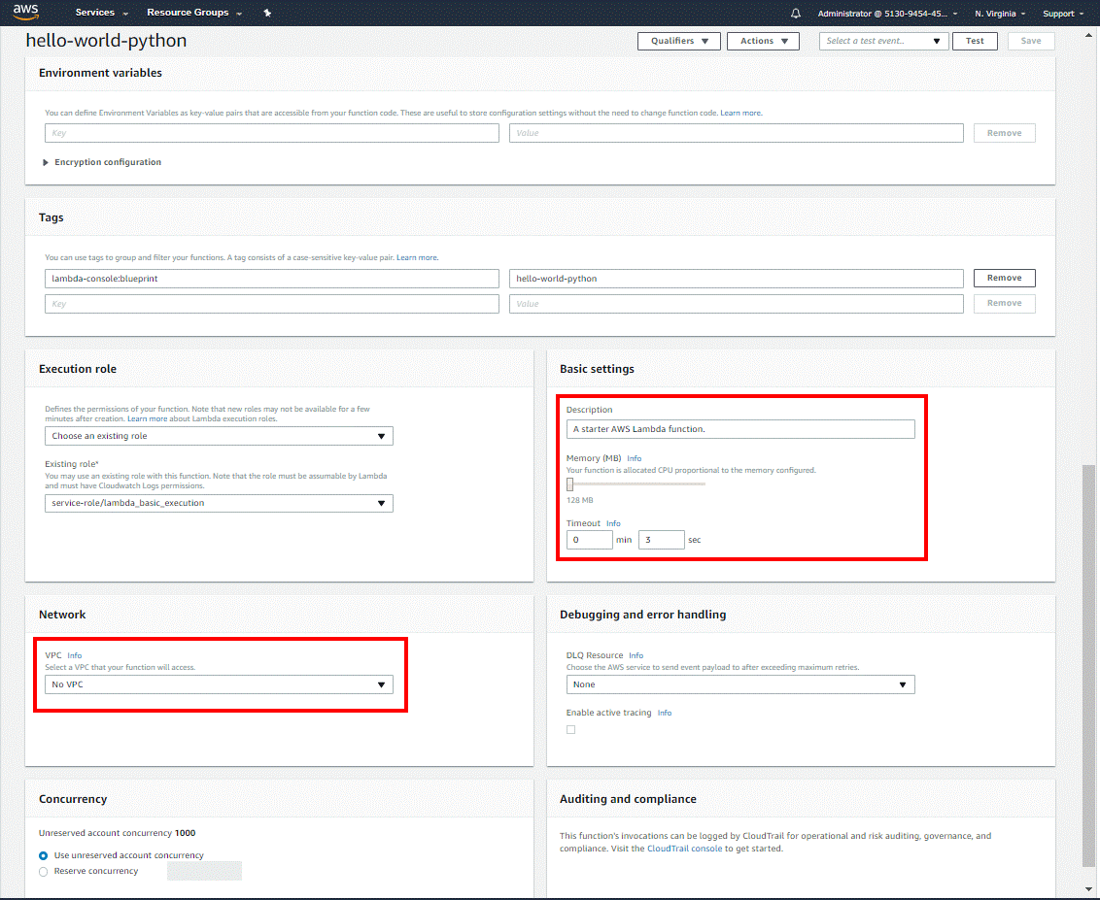
AWS Lambda Function
Future Configurations

Slide 63
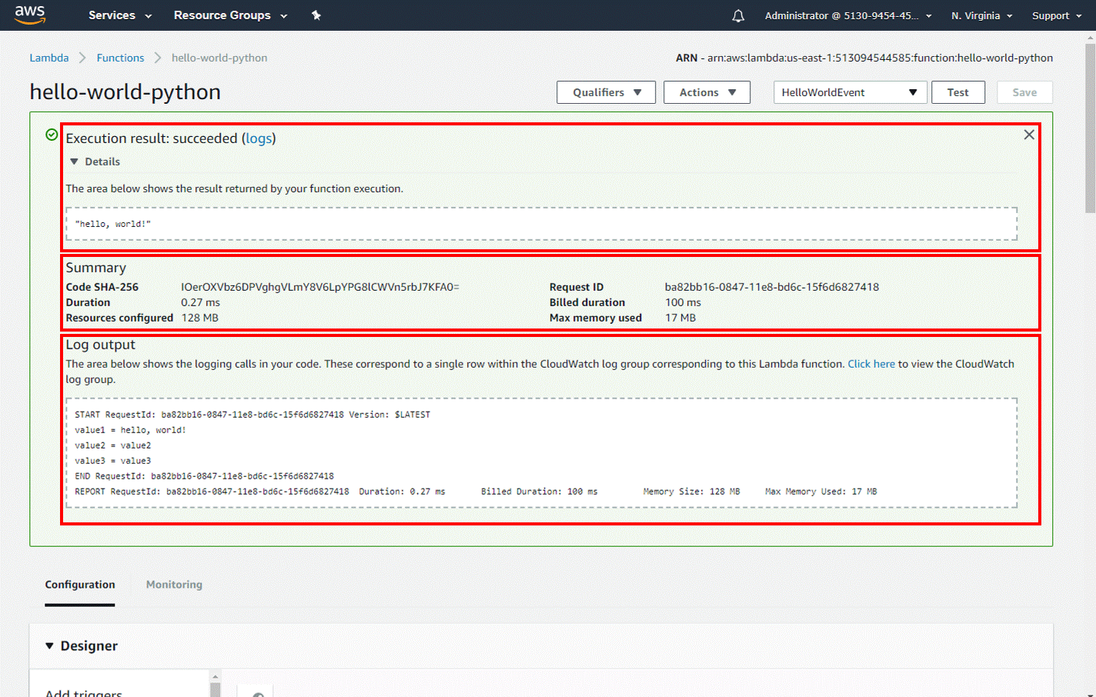
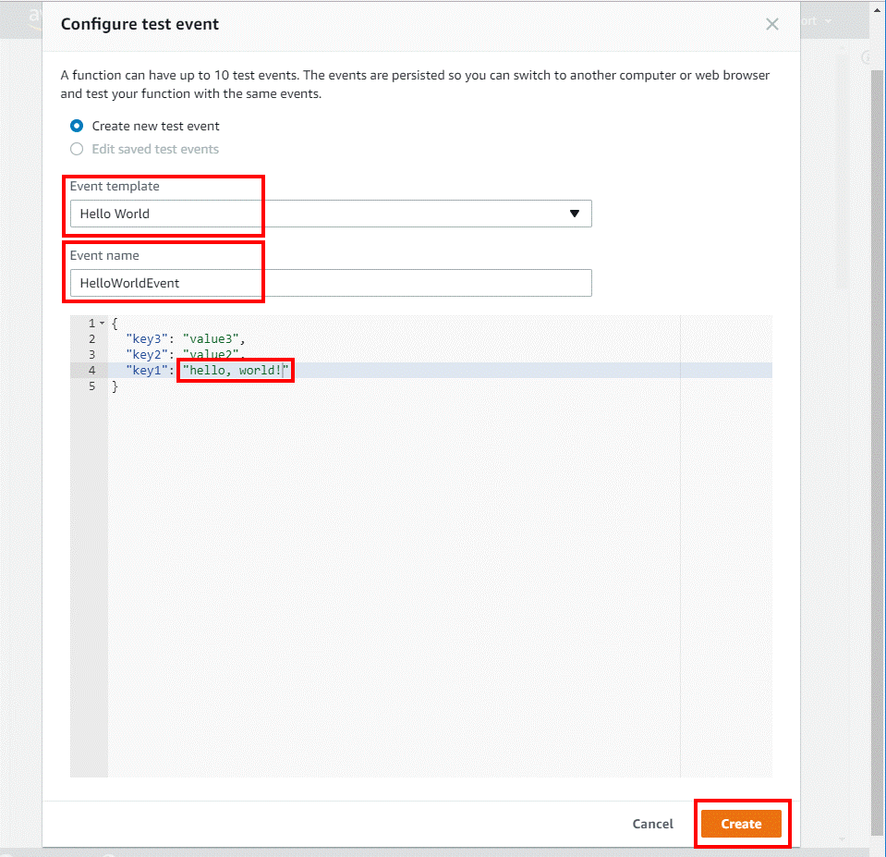
AWS Lambda Function
Test

